Slide 1



Goodreads Analysis
By Mark Pedraza

Slide 2


Project Goal and Importance
Goal: Analyze different attributes about books
Business Requirement
Do reviewers rate differently than non-reviewers?

Slide 3
Requirements Details
Functional Requirements
Number of users who gave ratings
Identifier for books to prevent duplicates (isbn possibly)
Number of ratings a book receives and the avg rating of the book
Number of written reviews and each reviewers rating score
Data Requirements
https://mengtingwan.github.io/data/goodreads.html#datasets

Slide 4
Solution to the Requirements
Data Architecture
Information Architecture
Technical Architecture
Technology Choices
Google Cloud Platform – Database
Google Dataproc – PySpark

Slide 5
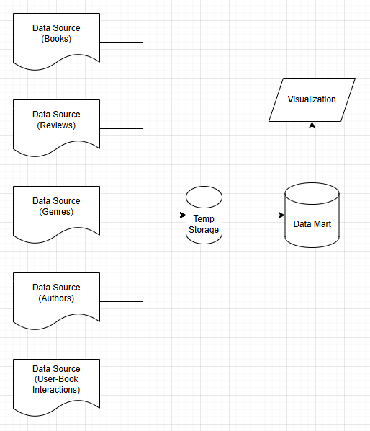

Slide 6
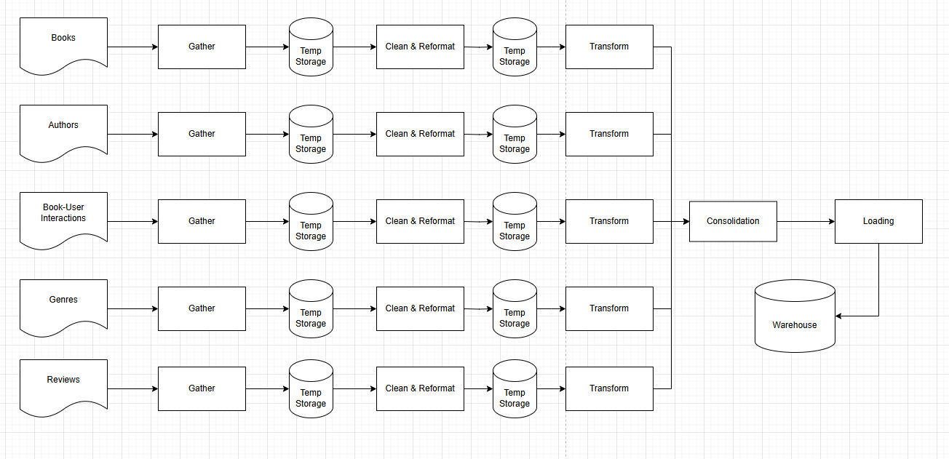

Slide 7
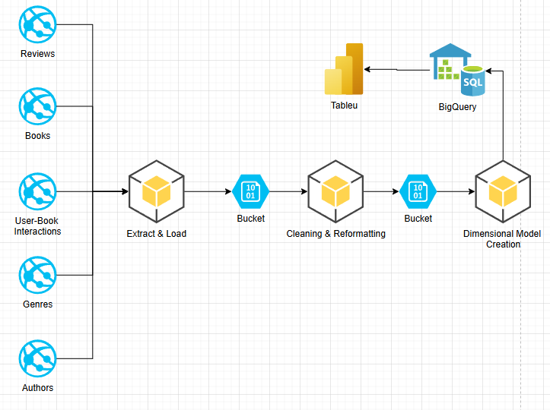

Slide 8
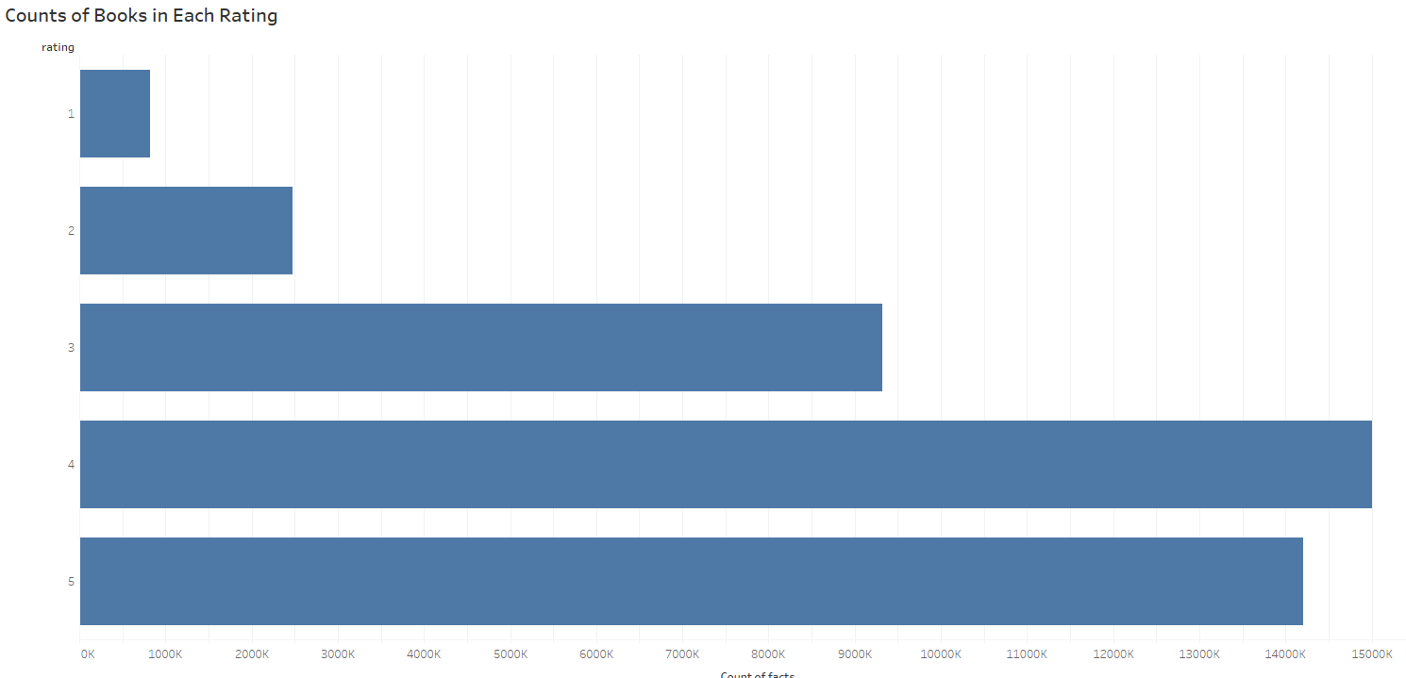
Summary of the results
Discuss your results with visualization, findings,
1
2
3
4
5

Slide 9
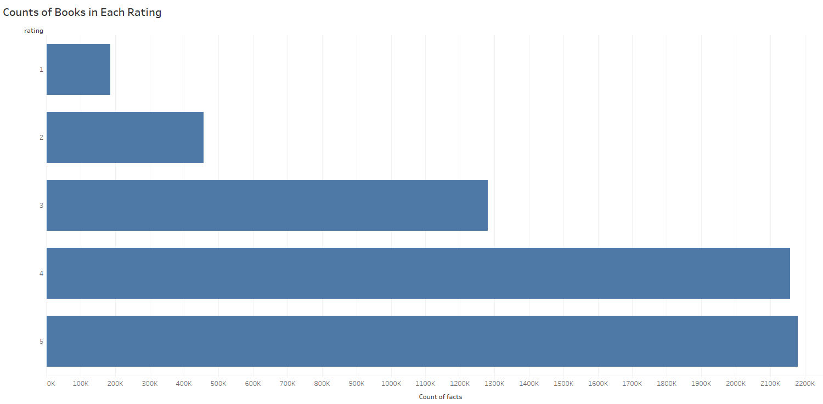
Summary of the results
Discuss your results with visualization, findings,
1
Small Increase in 1,2,5
Small Decrease in 3,4
2
3
4
5

Slide 10
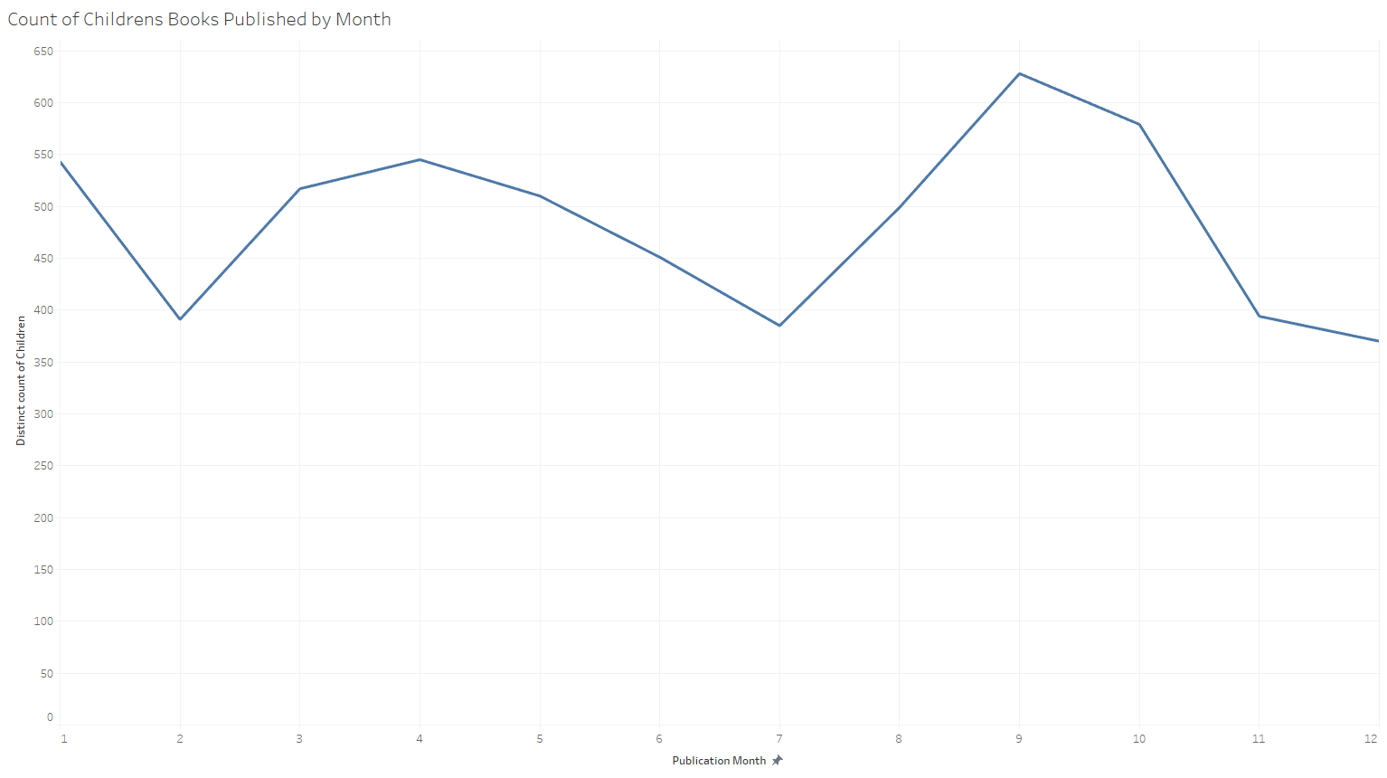
Summary of the results
1 2 3 4 5 6 7 8 9 10 11 12
1

Slide 11
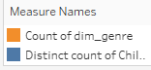
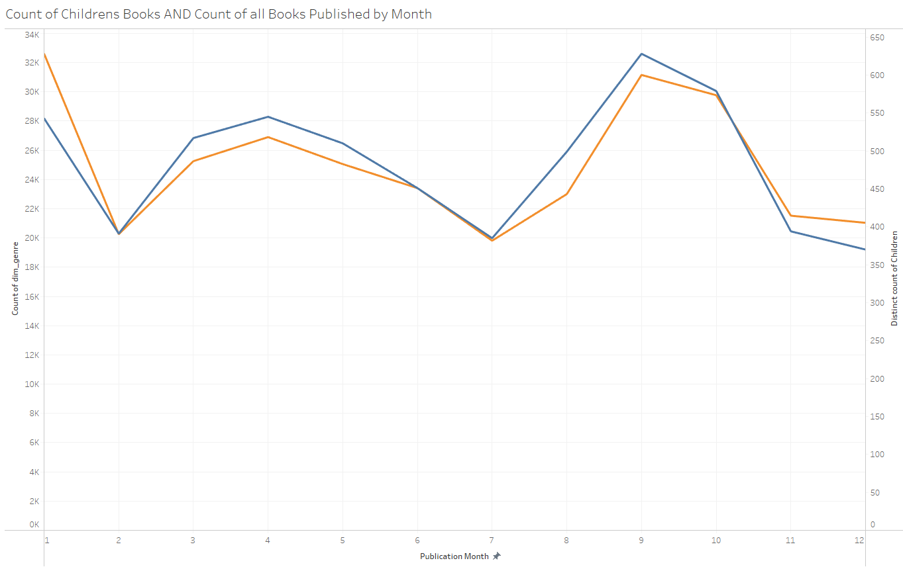
Summary of the results
1 2 3 4 5 6 7 8 9 10 11 12

Slide 12
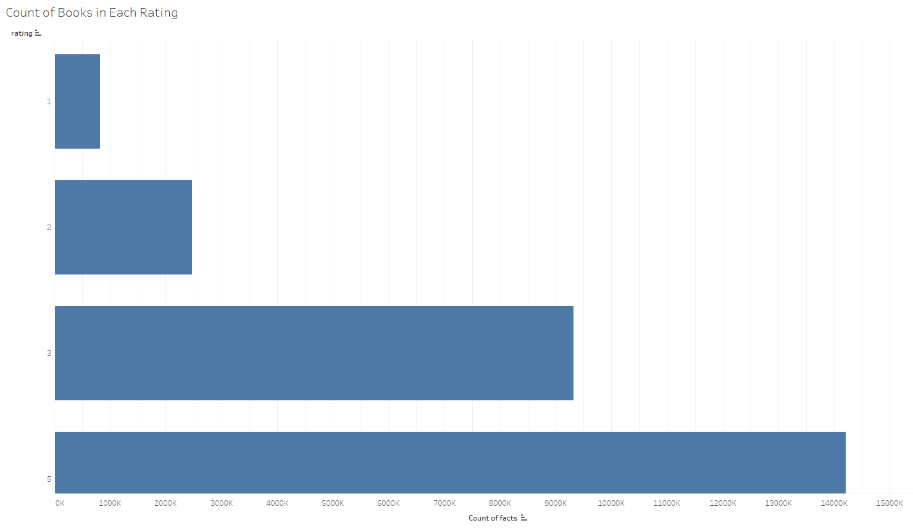
Summary of the results
1
2
3
5

Slide 13
Future Work
More visualizations (Lots more data I didn’t touch)
Possible Machine Learning for book recommendations
Requires significant time but half the work is done
Many models could help, such as Logistic Regression or KNN (Classification)
Could require more metadata about books for model training

Slide 14
Conclusion
We satisfied our business requirement (and them some)
Insight into trends and data
Ability to do much more

Slide 15


Thank You!

